Slide 1
Pre-Arranged Layoffs
June 1st, 2017
High Level Overview

Slide 2
Pre-Arranged Overview (TE&Y)
New programming in EAMS has been developed, allowing for TE&Y to pre-arrange their PL and LV layoffs 120 days in the future
Employees in the activated locations will be able to pre-arrange up to 7 PL or LV layoffs within a rolling 120 day period
  Note: Each day is 1 request
Pre-Arranged days are granted on a First Come-First Serve basis
The pre-arranged layoff will be a placeholder for the day approved, but it is the employee’s responsibility to “activate” the layoff by logging into EAMS via the web.
  Programming for automatically execute this layoff forthcoming- Requirements should be finalized by 6/15.
Given the nature of an unscheduled workforce, employees will also be able to advance or defer their layoff up to 16 hours from the arranged start time of the LV/PL day

Slide 3


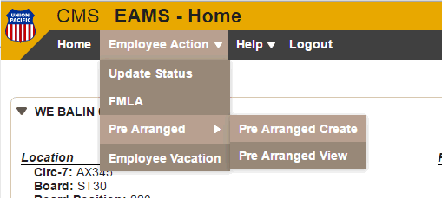
Pre-Arranged Overview:
Change of Status Screen
The interface used is the same “Employee Availability Management System” screen employees should be familiar with
From this application, the pre-arranged process can be accessed two ways:
  From Employee Action
  From the main screen accessing the Pre Arranged link

Slide 4
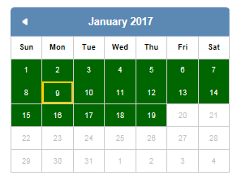
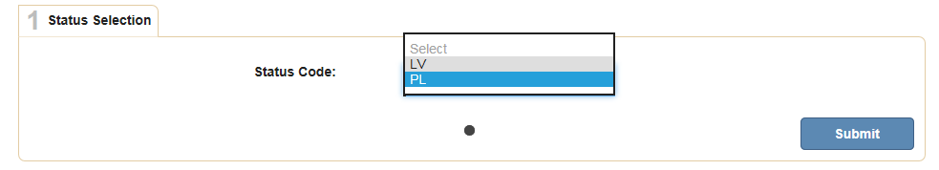
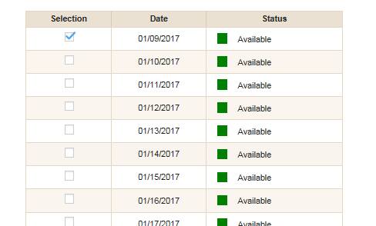

Pre-Arranged Overview:
Input Process
Select the available status
Select the date from the calendar
From the selection list, select the date(s) you wish to pre arrange

Slide 5
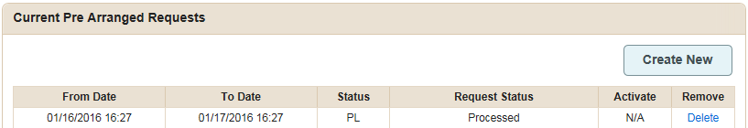
Pre-Arranged Overview:
Request Review
Once you select the days from the calendar and click next, you see a summary page. The info message above shows how many requests were approved or un-approved for the selection
From here you can also activate a request (if within 16 hours of the start date/time).

Slide 6
Pre-Arranged Overview:
Activation
You have the flexibility to activate early (up to 16 hours), or late (up to 16 hours) to better fit with your work schedule. Hit the “Activate” button
Once activated, you may either put in a new request, or go back to the main menu in EAMS to see your current information

Slide 7
Pertinent Notes
Activation: Layoffs will not execute automatically in CMTS, it is up to the employee to activate them
  If employee wants to activate and is outside of the 16 hour window, they will need to choose an immediate layoff as the pre arranged layoff is not permissible during the current window of time.
  If you have consecutive layoffs, these will all be activated at one time once you activate the first layoff in the block. Note: the consecutive layoffs have to be the same status (i.e. all PL or all LV)
EAMS Pre-Arranged & Immediate layoffs are synched up. If you have 2 PL’s left and both are arranged in the future, you will need to resolve one of those before laying off in an immediate fashion
Next Year PL/LV: There is an active feed between CMTS and EAMS in terms of vacation schedule and personal leave- Once the employee qualifies for PL/LV in the next year (fiscal or calendar), the PL/LV will now be available for selection.

Slide 8
Pertinent Notes: Continued
At this time, the following are exceptions to the current process
  Daily Preference - Currently there is no logic in the application to support pre-arranged layoffs for Daily Preference boards. In addition, Daily Preference boards typically have markup times that are fixed in order to mark boards, which is not supported. Enhancements to this process is planned 2017
  Supplemental Boards - Currently supp boards are not included with pre-arranged layoffs. Application does not support logic to pre-arrange for supplemental boards. - Enhancements to this process under review.
  Training Boards - Anyone permanently assigned to a training board will not be able to participate, as these boards do not show as part of a protecting extraboard.
  Additionally, any employee that is currently not on a protecting active board (Bump Board, Inactive board, Peer Trainer boards, etc.) will not be able to participate.
Activation Exceptions:
  At this time, you must be in some form of “OK” status to start your pre arranged day
  If laid off at the time, you must mark-up first, in order to be able to activate your layoff.

Slide 9
Future Enhancements: Round 1
Auto Activation - System automatically will pend the day, as well as allow the employee to change the time of activation within the activation window
Employee Edit: Additional controls for allowing employee to change from one status to another
Day now available: Additional logic to visually represent days that were originally unapproved but slots have opened up
Additional facelift changes

